Slide 1
Best practices nel mondo delle app
A scientific study on Diabetes Management apps
— Andrea Basilico
Prof. Francesco Pinciroli

Slide 2
Table of contents
INTRODUCTION
GOALS
METHODS
Diabetic self-management schema
Catalog of apps for diabetes management
One-shot pictorial schema
RESULTS
2

Slide 3
Introduction
Number of apps available on the App Store
1.3 million
(official data from Apple.com – September 2014)
Number of apps in the «Medical» category
~ 30.000 (2.5%)
2

Slide 4
Introduction
Segmentation of diabetes-related apps in the
«Medical» category
Diabetes management apps;
Single-featured apps;
Generic health-trackers;
Content consuption apps (e.g., magazine, journal, etc.);
2

Slide 5
Goals
Identification and analysis of mobile apps for diabetes management.
Classification of the apps through a one-shot pictorial schema.
2

Slide 6
Methods — Diabetic patient management knowledge schema
Background
Diabetes self-management schema
2

Slide 7
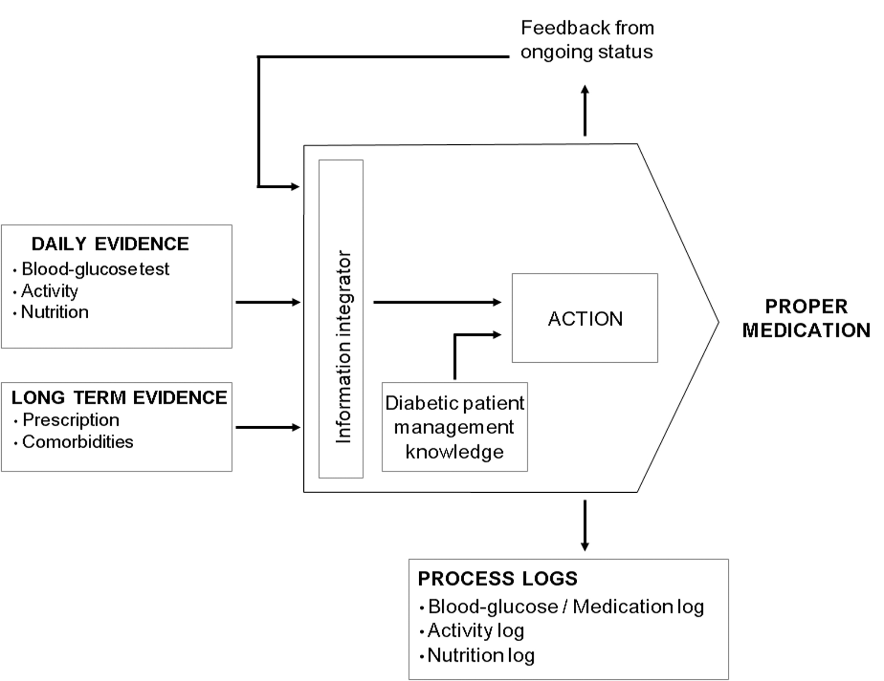
Methods — Diabetes self-management schema
2

Slide 8
Methods — Diabetes self-management schema
Frequency | Action | Blood-glucose / Medication log | Activity log | Nutrition log | Feedback from ongoing status | Proper medication
daily | blood-glucose test | x |  |  |  | x
 | activity |  | x |  |  | x
 | nutrition |  |  | x |  | x
long term | prescription |  |  |  | x | x
 | comorbidities |  |  |  |  | x
Here is considered only logging as it is available both on paper and mobile devices.
Mobile devices, however, in addition to logging, allow data representation and data delivery.
2

Slide 9
Methods — Catalog of apps for diabetes management
Catalog of apps
for diabetes management
available on App Store
2

Slide 10
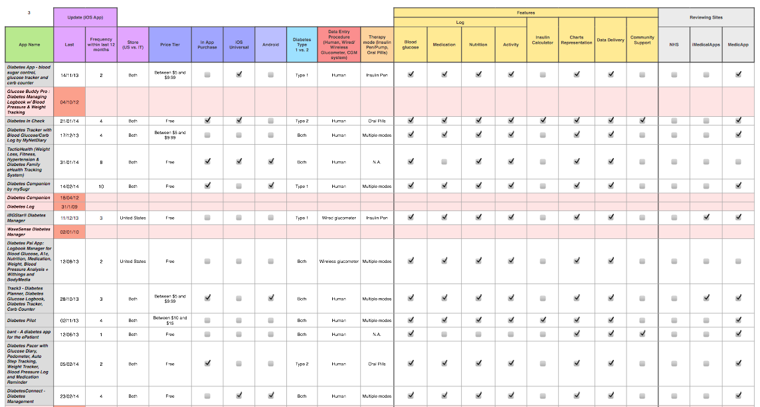
Methods — Catalog of apps for diabetes management
2

Slide 11
Methods — Catalog of apps for diabetes management
Update (iOS App): last, frequency within last 12 months;
Store (US vs. IT);
Price Tier;
In-App Purchase;
iOS Universal;
Android;
Diabetes Type (1 vs. 2);
Data Entry Procedure (Human, Wired/Wireless glucometer, CGM system);
Therapy mode (Insulin pen/pump, Oral pills);
Features: data log, insulin calculator, charts representation, data delivery, community support;
Reviewing sites: NHS, iMedicalApps, MedicApp;
2

Slide 12
Results — Catalog of apps for diabetes management
single-featured apps
generic health trackers
content consumption apps
Among 952 apps, just 41 apps
are relevant to our analysis.
2

Slide 13
Results — Catalog of apps for diabetes management
On average, an app receives 3.6 updates a year.
2

Slide 14
Results — Catalog of apps for diabetes management
2

Slide 15
Results — Catalog of apps for diabetes management
2

Slide 16
Results — Catalog of apps for diabetes management
2

Slide 17
Results — Catalog of apps for diabetes management
2

Slide 18
Results — Catalog of apps for diabetes management
A very small percentage of apps support the management of diabetes;
A significant number are not updated (abandoned);
Those “active” receive an update every 3/4 months on average;
There are no apps costing more than $15 and 2/3 are FREE;
The features implemented are mostly basic (data logging, representation, delivery). No significant percentage of advanced features (community support, calculators, etc.);
2

Slide 19
Methods — One-shot pictorial schema
One-shot pictorial schema
(Sample compilation)
2

Slide 20
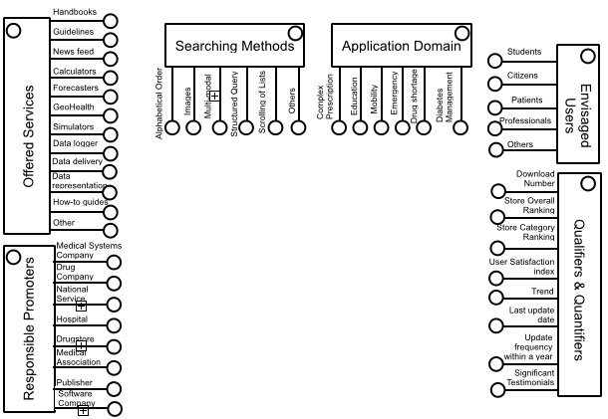
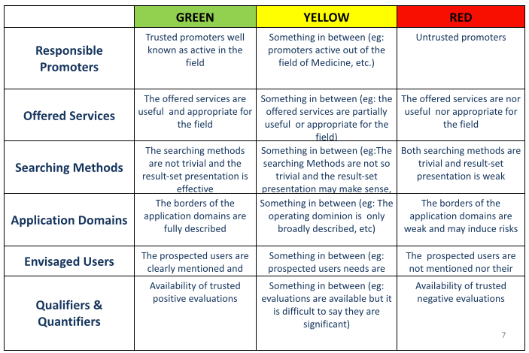
Methods — One-shot pictorial schema
2

Slide 21
Methods — One-shot pictorial schema (functional)
Handbooks
Guidelines
News feed
Searching Methods
Application Domain
Students
Calculators
Citizens
Forecasters
Others
Complex Prescription
Emergency
Diabetes Management
Mobility
Images
Education
Drug shortage
Alphabetical Order
Multi-modal
Scrolling of Lists
Patients
GeoHealth
Structured Query
Envisaged
Users
Simulators
Professionals
Offered Services
Data logger
Others
Data delivery
Data representation
Download Number
How-to guides
Diabetes HealthMate
(GlaxoSmithKline)
The Diabetes HealthMate is an easy-to-use mobile app that can help you track your blood sugar readings over time and visually chart how those readings relate to other factors in your life, like your mood, taking your medicines, activity level, and diet. Diabetes HealthMate also has a variety of activities to help you make positive lifestyle choices that can assist you with managing your diabetes every day.
Store Overall Ranking
Other
Store Category Ranking
Medical Systems Company
Drug Company
User Satisfaction index
National
Service
Qualifiers & Quantifiers
Trend
Hospital
Last update date
Responsible Promoters
Drugstore
Update frequency within a year
Medical Association
Significant Testimonials
Publisher
Software
Company
2

Slide 22
Methods — One-shot pictorial schema (usability)
Handbooks
Guidelines
News feed
Searching Methods
Application Domain
Students
Calculators
Citizens
Forecasters
Others
Complex Prescription
Emergency
Diabetes Management
Mobility
Images
Education
Drug shortage
Alphabetical Order
Multi-modal
Scrolling of Lists
Patients
GeoHealth
Structured Query
Envisaged
Users
Simulators
Professionals
Offered Services
Data logger
Others
Data delivery
Data representation
Download Number
How-to guides
Diabetes HealthMate
(GlaxoSmithKline)
The Diabetes HealthMate is an easy-to-use mobile app that can help you track your blood sugar readings over time and visually chart how those readings relate to other factors in your life, like your mood, taking your medicines, activity level, and diet. Diabetes HealthMate also has a variety of activities to help you make positive lifestyle choices that can assist you with managing your diabetes every day.
Store Overall Ranking
Other
Store Category Ranking
Medical Systems Company
Drug Company
User Satisfaction index
National
Service
Qualifiers & Quantifiers
Trend
Hospital
Last update date
Responsible Promoters
Drugstore
Update frequency within a year
Medical Association
Significant Testimonials
Publisher
Software
Company
2

Slide 23
Results — One-shot pictorial schema
The schema is a graphical representation tool to rapidly classify an app and understand its “value” for a specific compiler’s profile.
It offers different configurations depending on the compiler’s profile. This means that the distinction proposed is not the only one possible.
2

Slide 24
End
Thank you for your attention.
2

